Slide 1

Chronic Kidney Disease Risk Factor
Sade Graves
Final Project Presentation
12/5/24

Slide 2

Chronic Kidney Disease Rick Factor
Objective: Blood Urea Nitrogen Predication
Problem Type: Classification problem.
Dataset:
Number of Features : 29
Number of Instances: 600
After EDA Final Feature :
Train-Test Split Criteria:
To make accurate predictions, I used a stratified train-test split to ensure that the data samples in the test and train datasets were proportionate.

Slide 3

Conventional Models
Model Performance Summary Table
Models | Best Hyperparameters | Train Accuracy | Test Accuracy | Train F1 Score | Test F1 Score | Precision (Test) | Recall (Test) | Sensitivity (Test) | Specificity (Test)
Logistic Regression
Random Forest (RF)
Decision Tree
Gradient Boost

Slide 4
Deep Neural Network
Model Performance Summary Table
Set | Accuracy | F1 Score | Precision | Recall | Sensitivity | Specificity
Train
Validation
Test

Slide 5
Summary
Project Overview
Course Overview

Slide 6
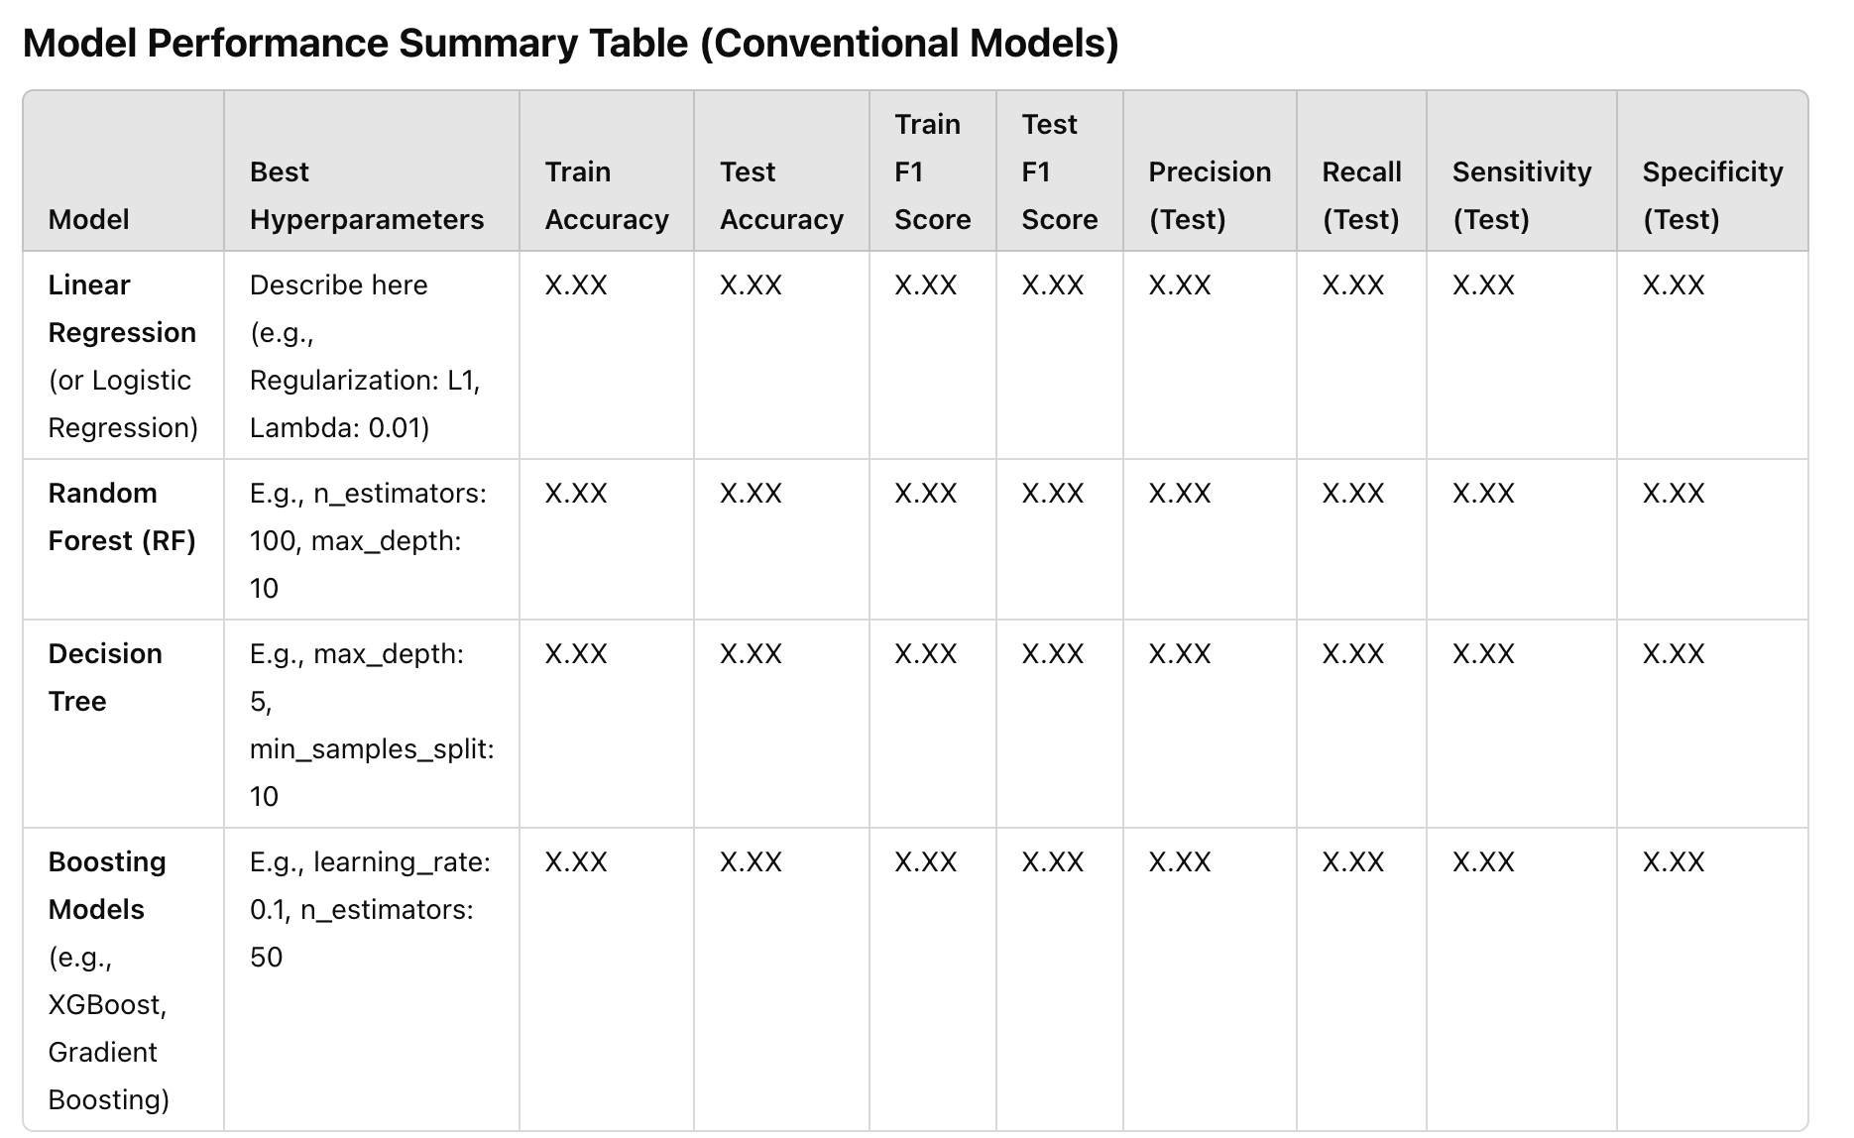
Conventional Models

Slide 7
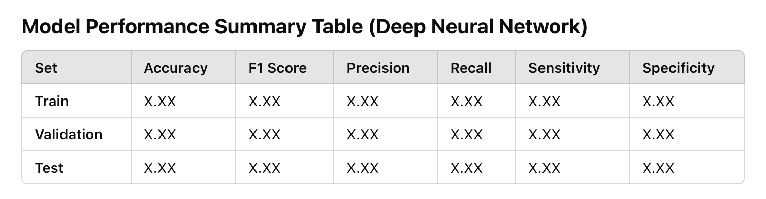
Title Here

Slide 8


